Slide 1



DISSERTATION PRESENTATION
DIZZINESS DETECTION USING CNN
SUBMITTED BY
AVANYA GUPTA
2020-310-040
B.TECH CSE
SUPERVISED BY
DR. JAWED AHMED
ASSISTANT PROFESSOR
SUBMITTED TO
DEPARTMENT OF COMPUTER SCIENCE & ENGINEERING
SCHOOL OF ENGINEERING SCIENCE & TECHNOLOGY
JAMIA HAMDARD

Slide 2
INTRODUCTION
Real Time Dizziness behaviors which are related to fatigue are in the form of eye closing, head nodding or brain activity. Hence, we can either measure change in physiological signals, such as brain waves, heart rate and eye blinking to monitor drowsiness or consider physical changes such as sagging posture, leaning of driver’s head and open/closed state of eyes. Sudden sleep associated with fatigue is caused by closed eyes, head nodding, or brain activity. Therefore, we can measure changes in physical activity such as brain activity, heart rate, and eye blinking to monitor fatigue, or calculate physical changes such as elevation loss, tilt of the driver's head, and eyes open/closed.

Slide 3
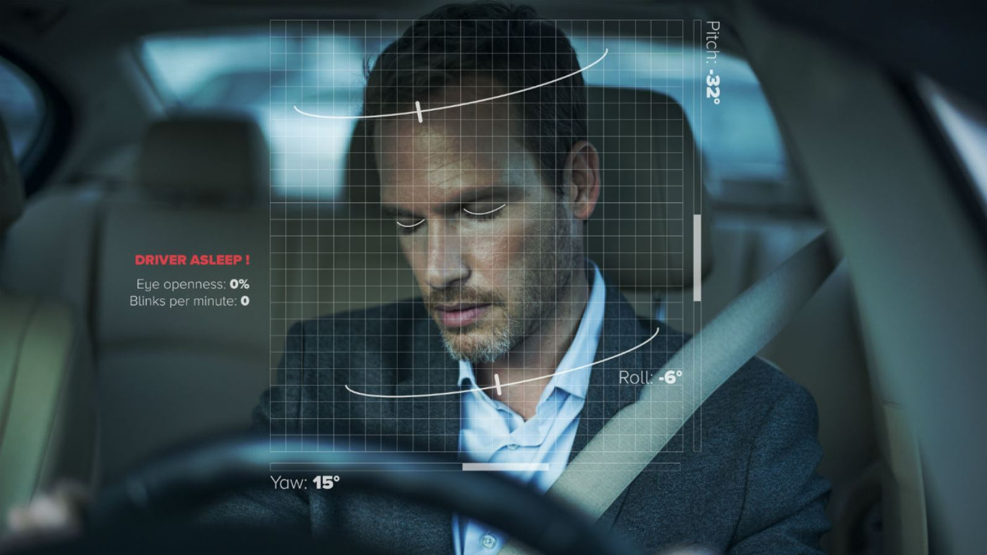
OBJECTIVE
The objective of a driver drowsiness detection machine learning project is to develop a robust and accurate system that can identify signs of driver fatigue or drowsiness in real-time. The primary goal is to enhance road safety by providing timely warnings or interventions to prevent potential accidents caused by drowsy driving.
Key elements:
Real-time detection
Alert system integration

Slide 4

PROBLEM STATEMENT
Drowsy driving is a significant cause of road accidents globally, leading to injuries and fatalities. The aim of this project is to develop a Driver Drowsiness Detection System using OpenCV and machine learning in Python to enhance road safety by alerting drivers when signs of drowsiness are detected.

Slide 5
Real-Time Detection: Implement a real-time drowsiness detection system that monitors the driver's facial features and eye movements using computer vision techniques provided by OpenCV.
Machine Learning Model: Train a machine learning model, such as a convolutional neural network (CNN) or a combination of classifiers, to accurately classify driver states as awake, drowsy, or in various stages of drowsiness.
Alert System: Implement an alert system that provides timely warnings to the driver when signs of drowsiness are detected. The alert system can include visual, auditory, or haptic signals to grab the driver's attention.
User-Friendly Interface: Develop a user-friendly interface that communicates the system's status and alerts to the driver. The interface should be intuitive and non-intrusive.

Slide 6
Pre-processing
MODEL ARCHITECTURE
Input image
Eye Detection
OpenCV, or Open Source Computer Vision Library, is an open-source computer vision and machine learning software library. It provides a set of tools and functions that enable developers to work with images and videos, performing tasks such as image processing, object detection, feature extraction, and more. OpenCV is written in C++ and has bindings for various programming languages, including Python.
Eye Aspect Ratio
Drowsiness Alert
Recognisation Tracking
Creating Bounding Box

Slide 7
SOFTWARE REQUIREMENTS
PyCharm is an integrated development environment (IDE) used for programming in Python. It provides code analysis, a graphical debugger, an integrated unit tester, integration with version control systems, and supports web development with Django.
Imutils: It is a collection of convenience functions for OpenCV, designed to simplify common image processing tasks and enhance the usability of the OpenCV library in Python. It is particularly useful for tasks related to computer vision and image processing
Pygame is a set of Python modules designed for writing video games. It provides functionalities for handling various multimedia elements, including graphics, sound, and user input.
Dlib: Dlib is a C++ toolkit primarily used for machine learning, computer vision, and image processing tasks. While it is primarily implemented in C++, it also provides Python bindings, making it accessible to a wider audience. Developed by Davis E. King, Dlib is an open-source library known for its efficiency, versatility, and powerful tools.
CV2: Cv2, also known as OpenCV (Open Source Computer Vision Library), is a popular open-source computer vision and image processing library. It is widely used in various fields such as robotics, machine learning, artificial intelligence, and computer vision.

Slide 8
LIMITATIONS
1. | Use of spectacles: In case the user uses spectacle then it is difficult to detect the state of the eye. As it hugely depends on light hence reflection of spectacles may give the output for a closed eye as an opened eye. Hence for this purpose the closeness of eye to the camera is required to avoid light.
2. | Multiple face problem: If multiple faces arise in the window then the camera may detect more faces and undesired output may appear. Because of the different conditions of different faces. So, we need to make sure that only the driver's face comes within the range of the camera. Also, the speed of detection reduces because of operation on multiple faces
3. | Lighting and Pose Variations: Despite preprocessing efforts, variations in lighting and driver poses can affect detection accuracy.

Slide 9
FUTURE WORK
1. | Integration with Vehicle Systems: Developing seamless integration with vehicle onboard systems to provide real-time feedback and automated intervention if necessary.
2. | Additional Sensors: Incorporating additional sensors like infrared cameras for better performance in low-light conditions and other physiological sensors for comprehensive driver monitoring.
3. | User Studies: Perform user studies to gather feedback on the system's usability, effectiveness, and impact on driver behavior, enabling continuous improvement based on real-world use cases.
4. | Edge Computing: Implement the system on edge devices (e.g., NVIDIA Jetson, Google Coral) to enable real-time processing directly on the device, reducing dependency on cloud computing and enhancing responsiveness.

Slide 10
SUMMARY
1 | Implemented feature extraction techniques such as Histogram of Oriented Gradients (HOG), Local Binary Patterns (LBP), and Eye Aspect Ratio (EAR). These features effectively captured essential facial characteristics necessary for drowsiness detection.
2 | Integrated the trained model into a real-time system using OpenCV for video capture and face detection. Successfully implemented a real-time alert mechanism that triggers an alarm when drowsiness is detected.
In this project, I have developed a real-time drowsiness detection system that leverages computer vision techniques and machine learning algorithms to enhance road safety by monitoring driver alertness. The system detects drowsiness by analyzing facial features, specifically the eye aspect ratio (EAR), to determine if the driver's eyes are closed for a prolonged period, indicating drowsiness.

